Slide 1

Design and Implementation of a Circuit to Count Ones in Binary Input
This project documentation covers the design and implementation of a digital circuit that counts the number of ones in a given 7-bit binary input. Created by a team of 4 students from PES University for the UE23CS251A Digital Design & Computer Organization course, this project even includes lab implication for digital circuit.

Slide 2


Project Overview
Project Architect
1
- Chaitanya Makkar
2
Circuit Design
-Chirag K M
Verilog Implementation
3
- Darshith M S
4
Testbench and Validation
- Chinmay Shivanand Muragod

Slide 3

Team Members
S.No
SRN
NAME
1
PES1UG23CS157
Chaitanya M
2
PES1UG23CS166
Chinmay Shivanand Muragod
3
PES1UG23CS167
Chirag K M
4
PES1UG23CS173
Darshith M S

Slide 4

Concept: Counting Ones in Binary Data
Binary Addition Principle
The addition of single binary bits in a row can be understood in terms of the number of ones present.
Examples
0 + 0 = 0 (No ones), 0 + 1 = 1 (One one), 1 + 1 = 10 (Two ones), 1 + 1 + 1 = 11 (Three ones)
Application
By adding all individual bits of a binary number, we can determine the total number of ones present.
7-Bit Input Choice
7 bits were chosen as the input size, allowing representation of up to 7 ones (111 in binary) using 3 output bits.

Slide 5

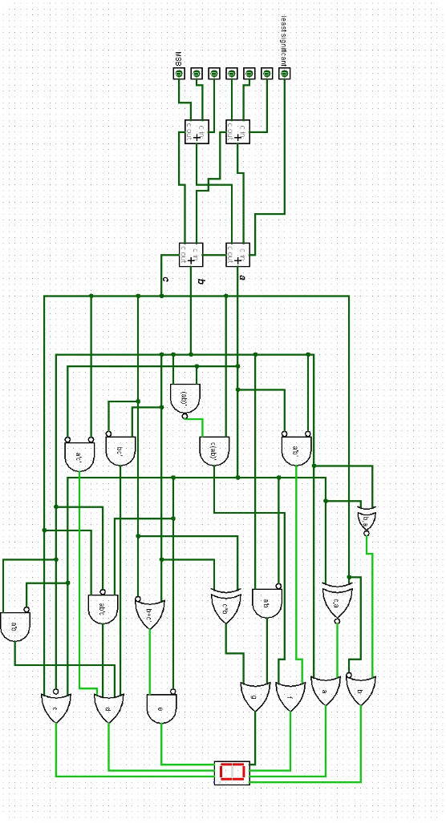




Circuit Design
The circuit design for counting the number of ones in a 7-bit binary input is illustrated in the attached image. The image shows how the full adders are interconnected to facilitate the counting process. Use of 7-segment display is being done. For the seven-segment display K-map and connections are attached as a GitHub link at last of this file. It uses 4-Full adders. The continued part after full adders is for lab implementation
Input Stage
7-bit binary input is fed into the circuit
Full Adder Network
4 full adders process the input bits
Output Stage
3-bit output represents the count of ones
Display
7-segment display shows the final count

Slide 6
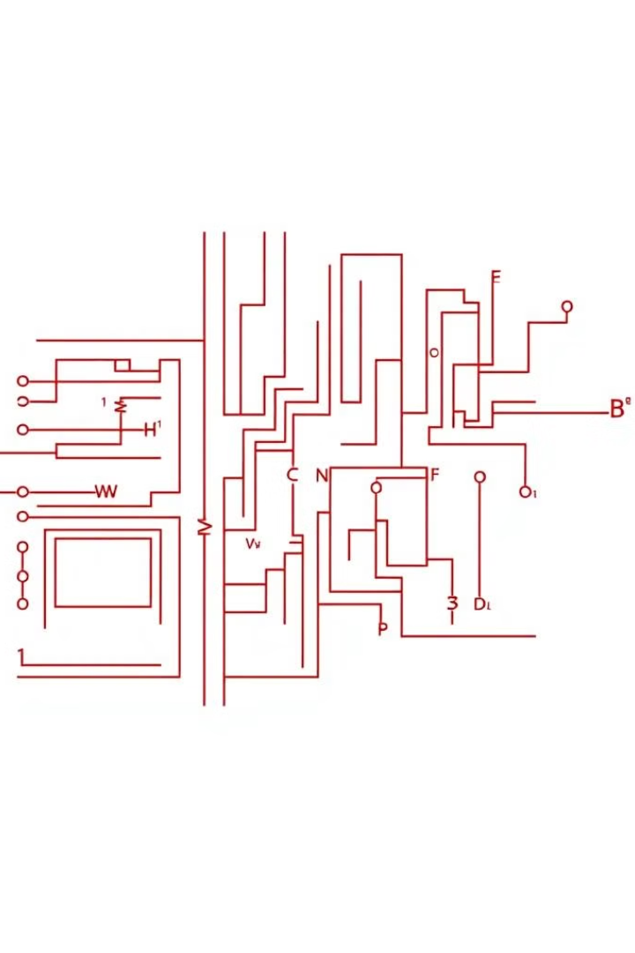
Verilog Implementation: Full Adder Module
module fulladder( input wire a, b, cin, output wire sum, cout ); assign sum = a ^ b ^ cin; assign cout = (a & b) | (cin & (a ^ b)); endmodule
1
Inputs
The full adder module takes three input wires: a, b, and cin (carry in)
2
Outputs
It produces two output wires: sum and cout (carry out)
3
Sum Calculation
The sum is calculated using XOR operations on all three inputs
4
Carry Out Calculation
The carry out is determined using Formulae:
Cout​=(A⋅B)+(A⊕B)⋅Cin​

Slide 7
Verilog Implementation: Sum Module
module sum( input wire [6:0] inp, output wire [2:0] op ); wire c1, c2, s1, s2, c3; fulladder a1 (.a(inp[3]), .b(inp[2]), .cin(inp[1]), .sum(s1), .cout(c1)); fulladder a2 (.a(inp[6]), .b(inp[5]), .cin(inp[4]), .sum(s2), .cout(c2)); fulladder a3 (.a(s1), .b(s2), .cin(inp[0]), .sum(op[0]), .cout(c3)); fulladder a4 (.a(c1), .b(c2), .cin(c3), .sum(op[1]), .cout(op[2])); endmodule
Input and Output
Full Adder Instances
Interconnections
The sum module takes a 7-bit input (inp) and produces a 3-bit output (op)
It uses four instances of the fulladder module (a1, a2, a3, a4) to process the input bits
The full adders are connected in a specific pattern to sum the input bits and produce the final count of ones

Slide 8




Testbench Implementation
`timescale 1ns/1ps module testbench; reg [6:0] inp; wire [2:0] op; sum uut ( .inp(inp), .op(op) ); initial begin inp = 7'b0100100; #10; inp = 7'b0110101; #10; inp = 7'b1010000; #10; inp = 7'b1111111; #10; $finish; end initial begin $monitor("At time %t: inp = %b (%d), op = %d", $time, inp,inp, op); end initial begin $dumpfile("waveform.vcd"); $dumpvars(0, testbench); end endmodule
Timing
Test Inputs
Uses 1ns/1ps timescale for precise simulation
Simulates various 7-bit input values
Monitoring
Waveform
Displays input and output values during simulation
Generates a VCD file for waveform visualization

Slide 9
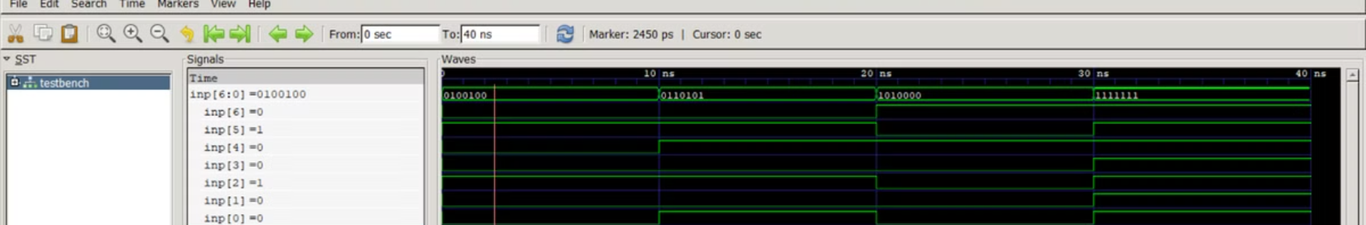
Execution and Results
Compilation
1
Commands to execute:
Iverilog -o pr filename.v testbench.v
Simulation Output
vvp pr
2
The compiler output shows the results of the simulation for different input values
gtkwave waveform.vcd
Waveform Visualization
3
GTKWave is used to visualize the simulation results in a waveform

Slide 10

Conclusion and Future Work
1
Successful Implementation
The project successfully designed and implemented a circuit to count ones in a 7-bit binary input
2
Practical Application
Demonstrates the application of digital logic concepts in solving real-world problems
3
Verification
The testbench and simulation results confirm the correct functionality of the circuit
4
Future Enhancements
Potential improvements could include extending the input size or optimizing the circuit for speed or area
For more details and the complete project files, please visit the GitHub repository: ilb225112/DDCO_mini_proj: 3rd Sem mini_proj for Digital Design and Computer Organization

